Slide 1

Quiz game

Slide 2

Requirements by the customer
•Make a quiz in a graphic program about object oriented programing
•14 questions
•Make it look nice (coloured,not black & white)
•Wireframe
•Design
•The usage of trello, figma and github .
•
•Must be finished before: 2024/03/28.

Slide 3
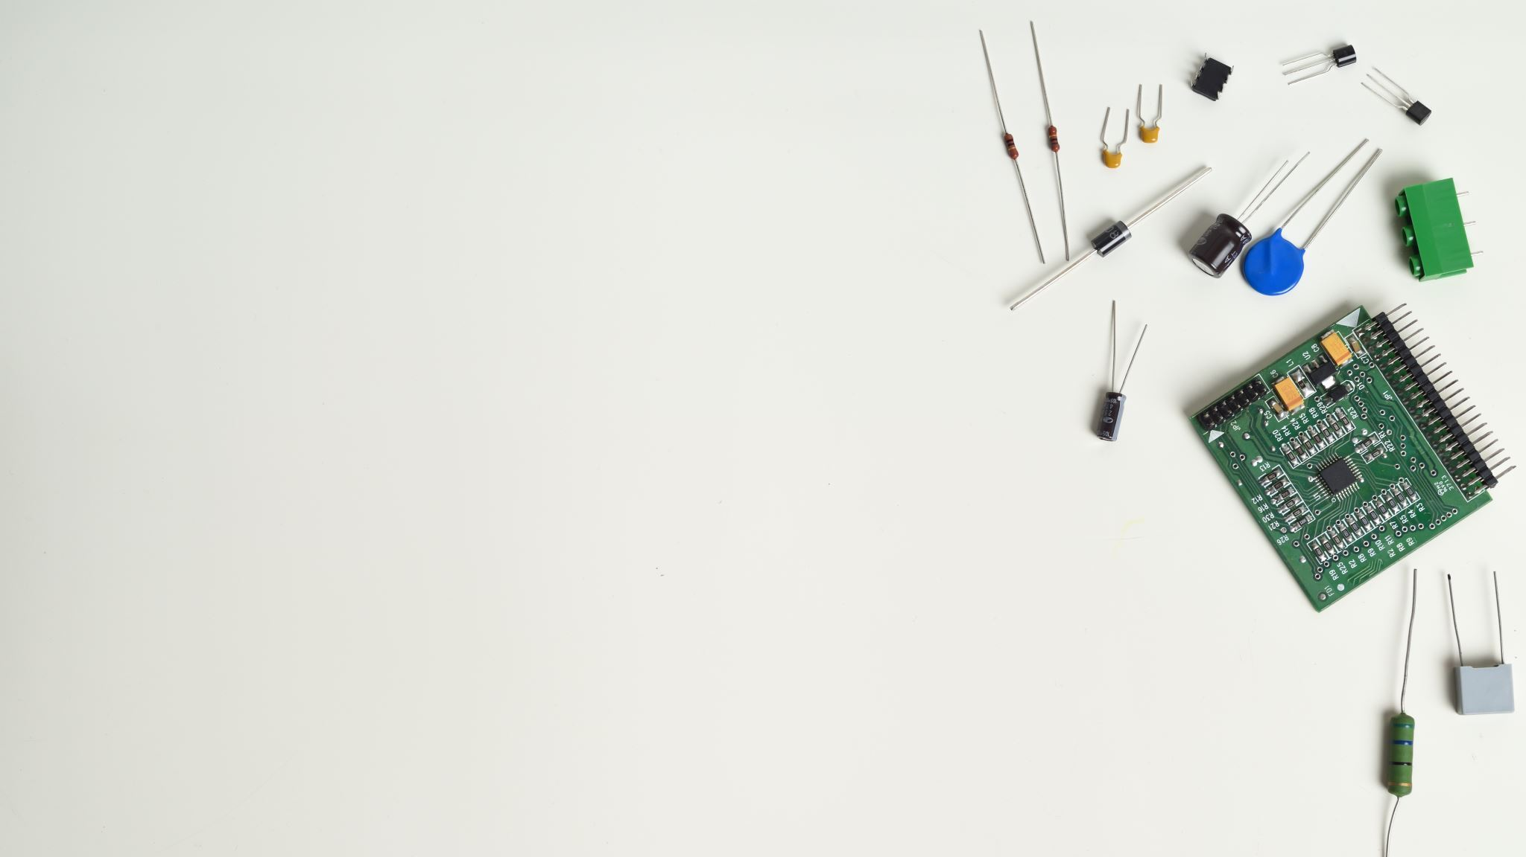
Staff and their jobs
Szöllősy Marcell: Design Creator, Powerpoint maker and Wireframe designer
Jankovics Dávid: Project Manager, Designer and Program Writer

Slide 4
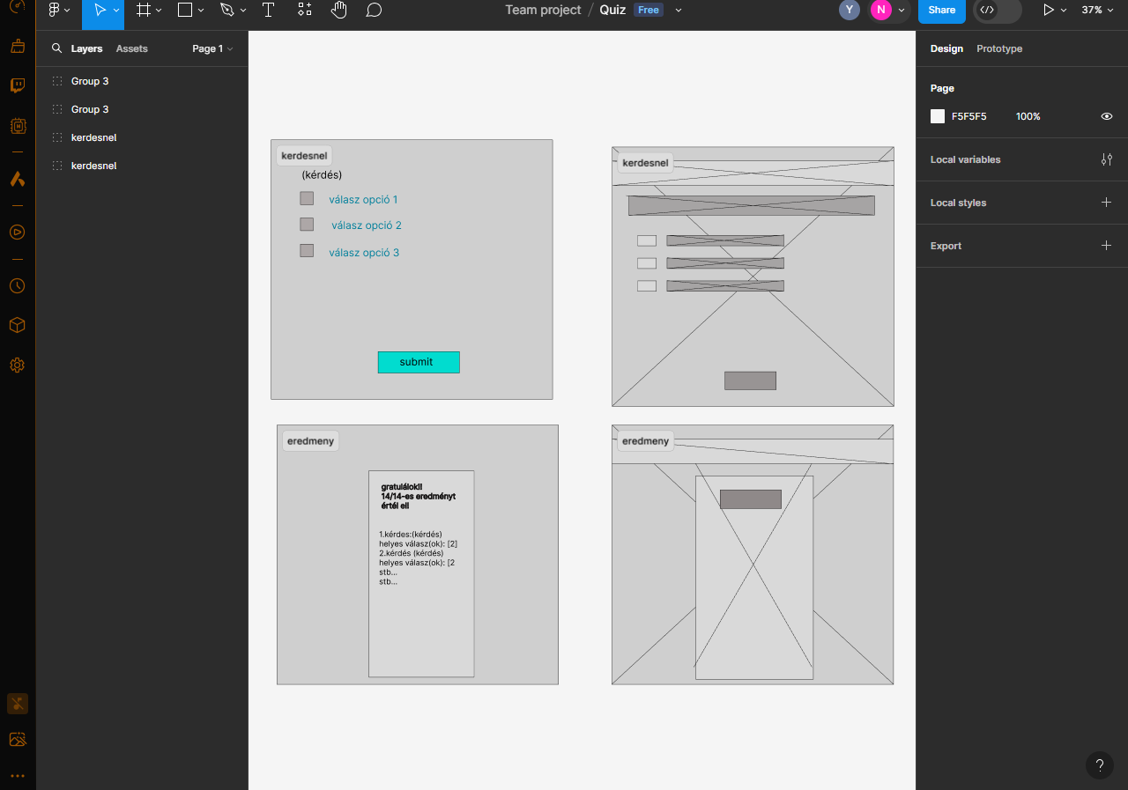
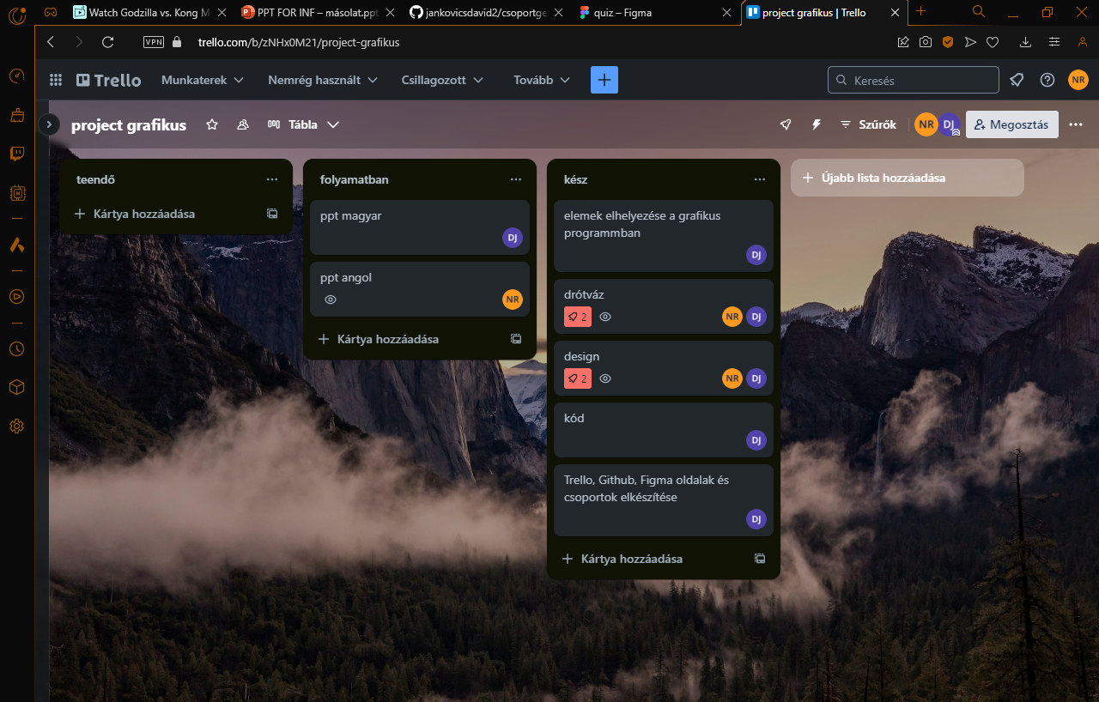
Apps we used
Figma: To create the basics for the design and for the wireframe
Trello: To make sure both of us knows what they have to do towards the project
Communications apps: To communicate ofcourse

Slide 5
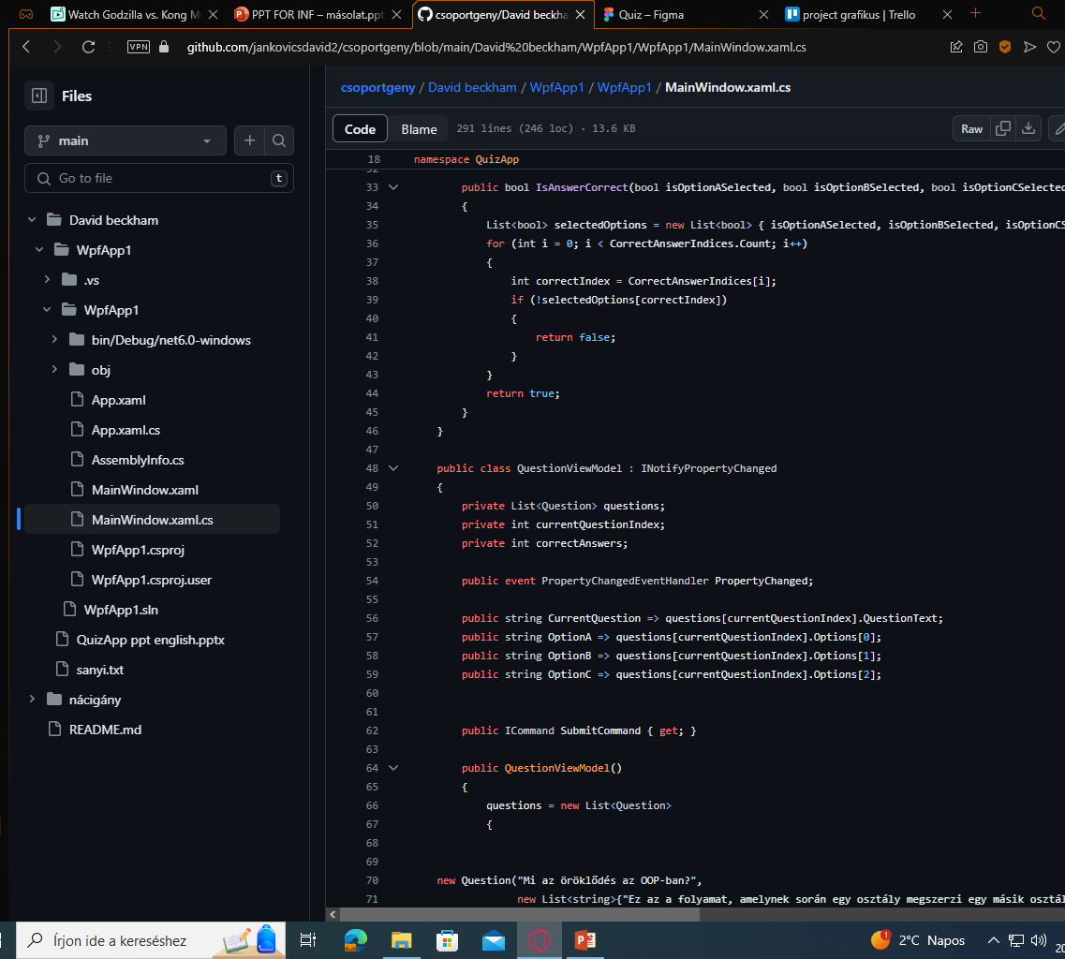
Codes we used
We have mostly used C# but we did put other codes in consideration
Such as:
Javascript

Slide 6
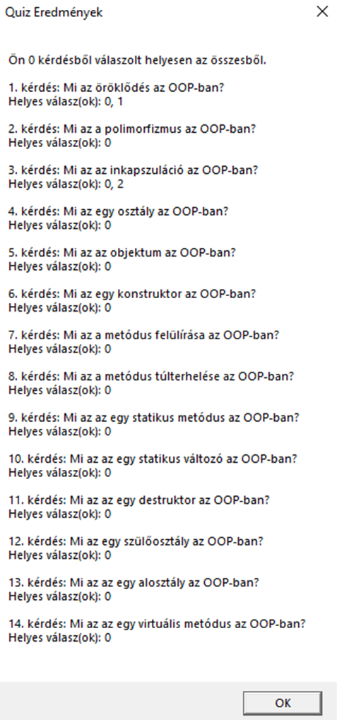
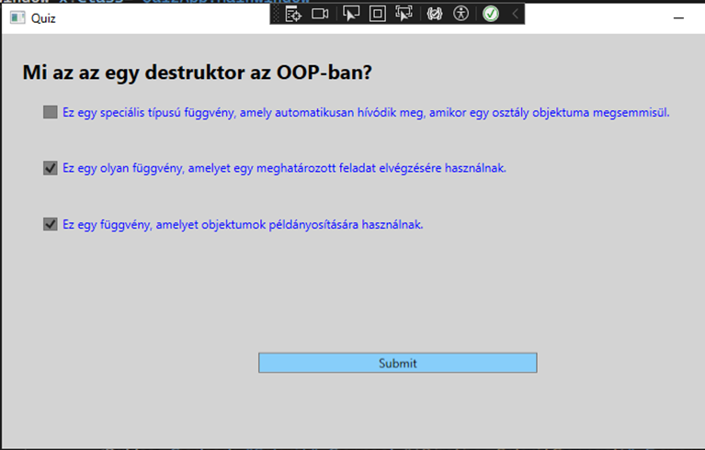
Features
•Interactive quiz interface
•Multiple-choice questions
•Submission and feedback mechanism

Slide 7


The full program

Slide 8

Thank you for your attention!

